Slide 1
MATHEMATICS FOR COMPUTING
WEEK 4 - LECTURE
MATRICES AND DETERMINANTS

Slide 2
Learning Outcomes
By the end of the lecture the successful student will be able to:
Determine the dimensions of a matrix.
Add and subtract two matrices.
Multiply a matrix by a scalar, sum scalar multiples of matrices.
Multiply two matrices together.
Understanding determinant of matrix.

Slide 3
Introduction to Matrices
A matrix is a rectangular array of numbers that is usually named by a capital letter: A,B,C, and so on. Each entry in a matrix is referred to as a_{ij}, such that i represents the row and j represents the column. Matrices are often referred to by their dimensions: m×n indicating m rows and n columns.
A row in a matrix is a set of numbers that are aligned horizontally. A column in a matrix is a set of numbers that are aligned vertically. Each number is an entry, sometimes called an element, of the matrix. Matrices (plural) are enclosed in [ ] or ( ) and are usually named with capital letters.

Slide 4

Introduction to Matrices
For example, three matrices named A,B, and C are shown below.
For example, to locate the entry in matrix A identified as a_{ij}, we look for the entry in row i, column j. In matrix A shown below, the entry in row 2, column 3 is a₂₃.

Slide 5


Introduction to Matrices
A square matrix is a matrix with dimensions n × n, meaning that it has the same number of rows as columns. The 3×3 matrix above is an example of a square matrix.
A row matrix is a matrix consisting of one row with dimensions 1 × n.
A column matrix is a matrix consisting of one column with dimensions m × 1.

Slide 6

Dimensions and Entries of the Matrix
Given matrix A:
The dimensions are 3 × 3 because there are three rows and three columns. Entry a₃₁ is the number at row 3, column 1 which is 3. The entry a₂₂ is the number at row 2, column 2 which is 4. Remember, the row comes first, then the column.

Slide 7
Adding and Subtracting Matrices
The addition and subtraction of matrices is only possible when the matrices have the same dimensions. We can add or subtract a 3 × 3 matrix and another 3 × 3 matrix, but we cannot add or subtract a 2 × 3 matrix and a 3 × 3 matrix because some entries in one matrix will not have a corresponding entry in the other matrix.
Given matrices A and B of like dimensions, addition and subtraction of A and B will produce matrix C or matrix D of the same dimension.
A+B = C such that a_{ij} + b_{ij} = c_{ij}
A−B = D such that a_{ij} – b_{ij} = d_{ij}

Slide 8
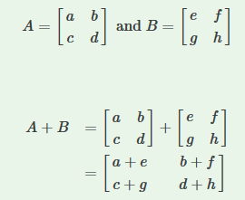


Finding the Sum of Matrices A and B given
Example:
Given the matrices:
A + B is,

Slide 9
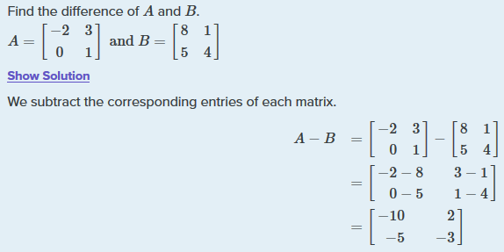
Difference of Two Matrices
Example:

Slide 10
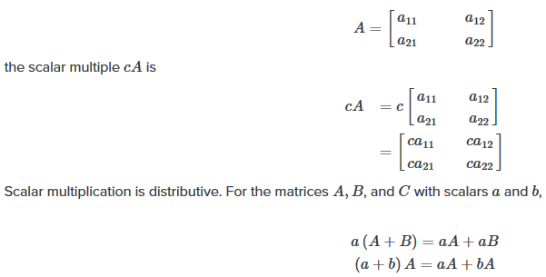
Products of Matrices
There are many situations in which we need to multiply a matrix by a constant called a scalar.
Scalar multiplication involves finding the product of a constant by each entry in the matrix. Given

Slide 11

Products of Matrices
Finding the product of two matrices is only possible when the inner dimensions are the same meaning that the number of columns of the first matrix is equal to the number of rows of the second matrix.
To obtain the entries in row i of AB, we multiply the entries in row i of A by column j in B and add. For example, given matrices A and B, where the dimensions of A are 2 × 3 and the dimensions of B are 3 × 3, the product of AB will be a 2 × 3 matrix.

Slide 12
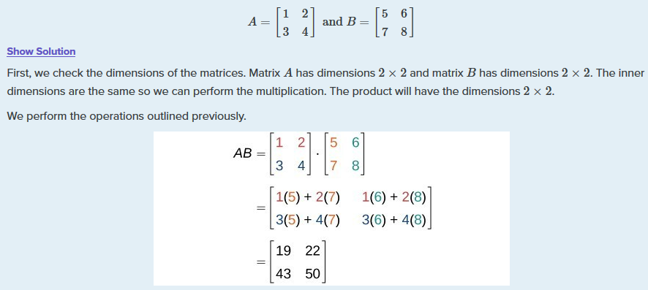
Products of Matrices
Example:

Slide 13
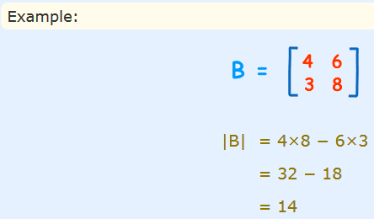
Determinant of a Matrix
The determinant helps us find the inverse of matrix, tells us things about the matrix that are useful in systems of linear equations, calculus and more.
Example:
|A| means the determinant of the matrix A.
For a 2×2 Matrix
For a 2×2 matrix (2 rows and 2 columns):

Slide 14
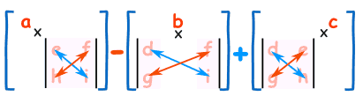
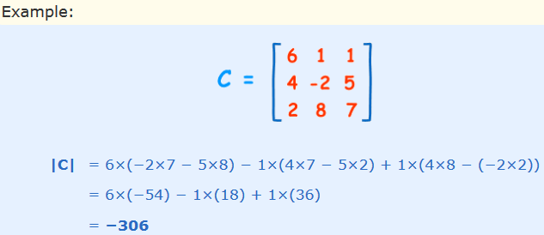
Determinant of a Matrix
For a 3×3 matrix (3 rows and 3 columns):
The determinant is:
|A| = a(ei − fh) − b(di − fg) + c(dh − eg)
It may look complicated, but there is a pattern:

Slide 15
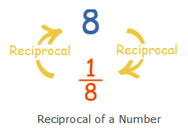
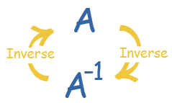
Inverse of a Matrix
With matrices we don't divide! Seriously, there is no concept of dividing by a matrix. But we can multiply by an inverse, which achieves the same thing.
The inverse of a square matrix, sometimes called a reciprocal matrix, is a matrix such that
A A ⁻¹ = I

Slide 16
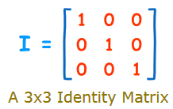
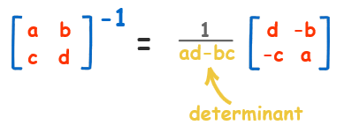
Identity Matrix
It is "square" (has same number of rows as columns),
It has 1s on the diagonal and 0s everywhere else.
Its symbol is the capital letter I.
for a 2x2 matrix the inverse is:
Swap the positions of a and d, put negatives in front of b and c, and divide everything by the determinant (ad-bc).

Slide 17
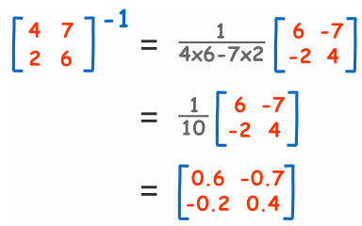
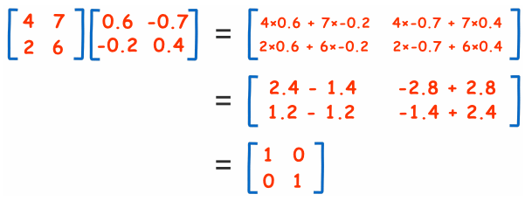
Identity Matrix
Example:

Slide 18
References
https://www.khanacademy.org/math/precalculus/x9e81a4f98389efdf:matrices/x9e81a4f98389efdf:mat-intro/a/intro-to-matrices
https://en.wikipedia.org/wiki/Matrix_(mathematics)
https://brilliant.org/wiki/matrices/
https://www.statisticshowto.com/matrices-and-matrix-algebra/
https://www.youtube.com/watch?v=yRwQ7A6jVLk

Slide 19
Done for Today
Thank You

